Slide 1


HCP Journey Workshop 2
Friday 23rd March
Core project team

Slide 2
Journey Principles
What is the priority?
Practical / Pragmatic
Reflect brand plan and prioritization of activation
Simple
Addressing customer needs and preferences – leveraging market research (content, channel, style, time)
Actionable today = channel maturity, content is there, or where consent is required
Powered by Insight & data (try to combine where possible to see 360 view)
‘Aligned to CRM/CDP’
Various access points (into journey)
Linked to key events
Journeys are connected and not in isolation
Leverages digital and physical touchpoints
Based on fact, not feeling (where possible)

Slide 3



Tool Comparison
Easily Editable – Basic Changes
Easily Editable – Structural Changes
Learning Curve
Live Collaboration
Flexibility
Readability
Full map visualisation
Guided Journey Creation
Cost

Slide 4
Option 1
PowerPoint

Slide 5
The PPT touchpoint principles
Fill the space with useful information – the touchpoints are priority from a UX perspective
Standard format across pages for navigation
7 steps per adoption stage (marketing rule of thumb)
The more descriptive each touchpoint is the easier it is to execute:
Channel – Goal of Interaction - Message – Link to Content – KPIs – Link to playbooks
Experience – can result in huge files that have usage limitations.
Quick changes are often difficult and require lots of moving things around
Need to be easily copied into a PPT for presenting the outputs clearly.
Option could be to to design in a tool, and manage elsewhere.

Slide 6



Behaviour Change
CURRENT
Uses a very broad spectrum of products including JAKs
Uses very recently launched products
Able to talk extensively about new and pipeline treatments
Willing to act ahead of guidelines
DESIRED
Tries JYSELECA with some patients
(After they have gained experience) Expand JYSELECA use in a wider range of patients in preference to other JAKs
Unmet Need
Research
1st Rx
Prescribes
Advocates
Adoption Stage
#1
#2
#3
#4
#5
Mavericks: insert here
Pragmatists: insert here
Compassionates: Insert here
Galapagos Goal
Highly competitive environment with comparisons between treatments hard to make.
Treatment inertia and need to overcome mindset shift
Barriers
Mvrks
Messages
Prgmts
Cmpsts
Message Source
KOL Video
Study x
Guidelines

Slide 7
Menu page with all slides visualised for easy navigation

Slide 8




Journey
Scenario 1
1 - Unmet Need Uses a wide variety of treatments 1st line, including JAKs
2 - Research: Uses a wide variety of treatments 1st line, including JAKs
Galapagos Goal: Insert the Galapagos goal from the current adoption stage here
Adoption Stage Barrier: Insert Galapagos the barrier for the current adoption stage here

Slide 9
Mavericks
Scenario 1
1 - Unmet Need Uses a wide variety of treatments 1st line, including JAKs
2 - Research: Uses a wide variety of treatments 1st line, including JAKs
Galapagos Goal: Insert the Galapagos goal from the current adoption stage here
Adoption Stage Barrier: Insert Galapagos the barrier for the current adoption stage here

Slide 10




Journey
Scenario 1
1 - Unmet Need Uses a wide variety of treatments 1st line, including JAKs
2 - Research: Uses a wide variety of treatments 1st line, including JAKs
Galapagos Goal: Insert the Galapagos goal from the current adoption stage here
Adoption Stage Barrier: Insert Galapagos the barrier for the current adoption stage here
VAE
Goal of Interaction
Email Message / theme
Informative links
How the touchpoints are connected with enough room for some detail, links and more information
← Too much detail
Not supposed to be exhaustive
80 AE fragments – can’t possibly include all these in the journeys – this is illustrative
10 journeys to capture the key flows, the must haves,
Important to demo how the channels CAN be connected together and fit into a journey
(sent email doesn’t mean opened or understood)
Mastery of the basics/key elements for Launch – core channel execution (eg no whatsapp) (also visualising what a differentiated campaign would be in these journeys)
ACTION: Show upfront that we’re focusing on the core 10 flows, and what they’re for.
What is intent of AE? Demonstrate this in the journeys
Link to Content
KPIs – 40 % Open Rate | 25% CTR
VAE Playbook
F2F Visit
Goal of Interaction
Key Messages to deliver
Link to Content
KPIs – Call length| Content Reaction
CLM Playbook

Slide 11
Mavericks
Scenario 1
1 - Unmet Need Uses a wide variety of treatments 1st line, including JAKs
2 - Research: Uses a wide variety of treatments 1st line, including JAKs
Galapagos Goal: Insert the Galapagos goal from the current adoption stage here
Adoption Stage Barrier: Insert Galapagos the barrier for the current adoption stage here
Journey 1
Journey 2

Slide 12
Mavericks
Scenario 1
1 - Unmet Need Uses a wide variety of treatments 1st line, including JAKs
2 - Research: Uses a wide variety of treatments 1st line, including JAKs
Galapagos Goal: Insert the Galapagos goal from the current adoption stage here
Adoption Stage Barrier: Insert Galapagos the barrier for the current adoption stage here
May | June | July

Slide 13
Mavericks
Scenario 1
1 - Unmet Need Uses a wide variety of treatments 1st line, including JAKs
2 - Research: Uses a wide variety of treatments 1st line, including JAKs
Galapagos Goal: Insert the Galapagos goal from the current adoption stage here
Adoption Stage Barrier: Insert Galapagos the barrier for the current adoption stage here
VAE
Goal of Interaction
Email Message / theme
Informative links
How the touchpoints are connected with enough room for some detail, links and more information
Link to Content
KPIs – 40 % Open Rate | 25% CTR
VAE Playbook
F2F Visit
Goal of Interaction
Key Messages to deliver
Link to Content
KPIs – Call length| Content Reaction
CLM Playbook

Slide 14
Scenario 1
1 - Unmet Need Uses a wide variety of treatments 1st line, including JAKs
2 - Research: Uses a wide variety of treatments 1st line, including JAKs
Galapagos Goal: Insert the Galapagos goal from the current adoption stage here
Adoption Stage Barrier: Insert Galapagos the barrier for the current adoption stage here
VAE
Goal of Interaction
Email Message / theme
Link to Content
KPIs – 40 % Open Rate | 25% CTR
VAE Playbook
VAE
Goal of Interaction
Email Message / theme
Link to Content
KPIs – 40 % Open Rate | 25% CTR
VAE Playbook

Slide 15
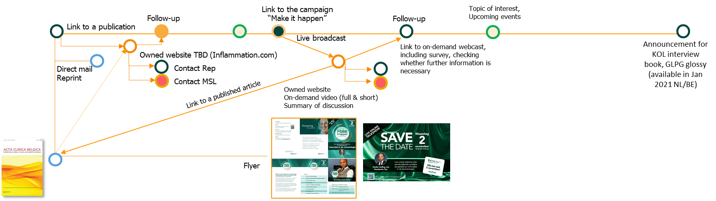
Mavericks
Scenario 1
1 - Unmet Need Uses a wide variety of treatments 1st line, including JAKs
2 - Research: Uses a wide variety of treatments 1st line, including JAKs
Galapagos Goal: Insert the Galapagos goal from the current adoption stage here
Adoption Stage Barrier: Insert Galapagos the barrier for the current adoption stage here
Other option is a more ‘map-like’ layout with less information but more connections

Slide 16
Option 2
Custellence

Slide 17
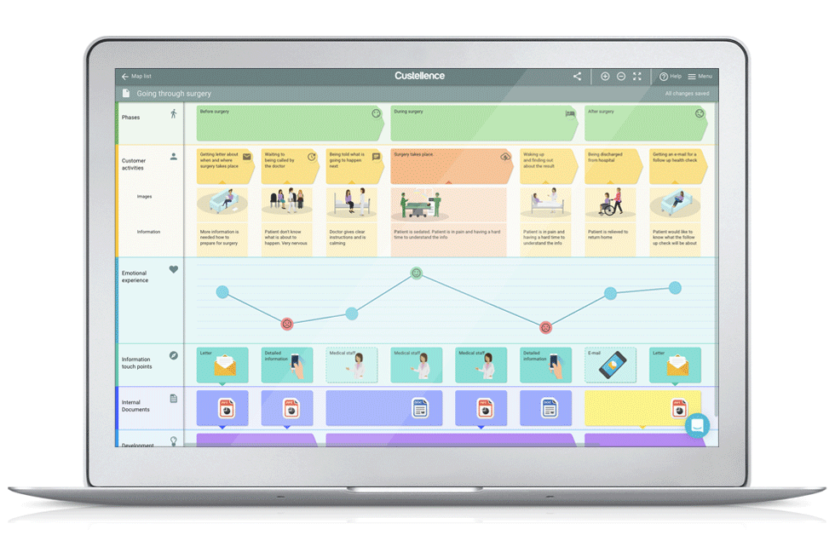
Custellence
After comparing a multitude of tools, we believe Custellence has the best balance of features vs simplicity, with simplicity being key.
No journey mapping tools discovered have simple integrations with CRM
All tools allow for exporting the journeys, however exporting in aspect ratio suitable for PPT always requires some finesse.
Other tools have more functionality, or more customisation, but at a simplicity cost that is too significant.

Slide 18
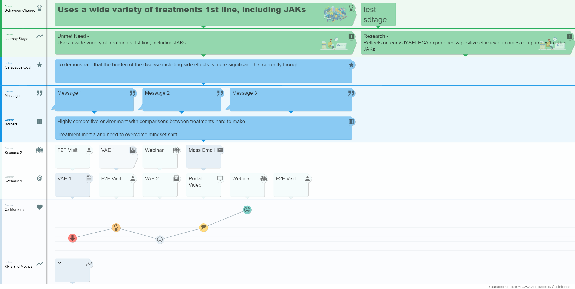
Custellence
After comparing a multitude of tools, we believe Custellence has the best balance of features vs simplicity, with simplicity being key.
No journey mapping tools discovered have simple integrations with CRM
All tools allow for exporting the journeys, however exporting in aspect ratio suitable for PPT always requires some finesse.
Other tools have more functionality, or more customisation, but at a simplicity cost that is too significant.

Slide 19
Option 3
Mural

Slide 20
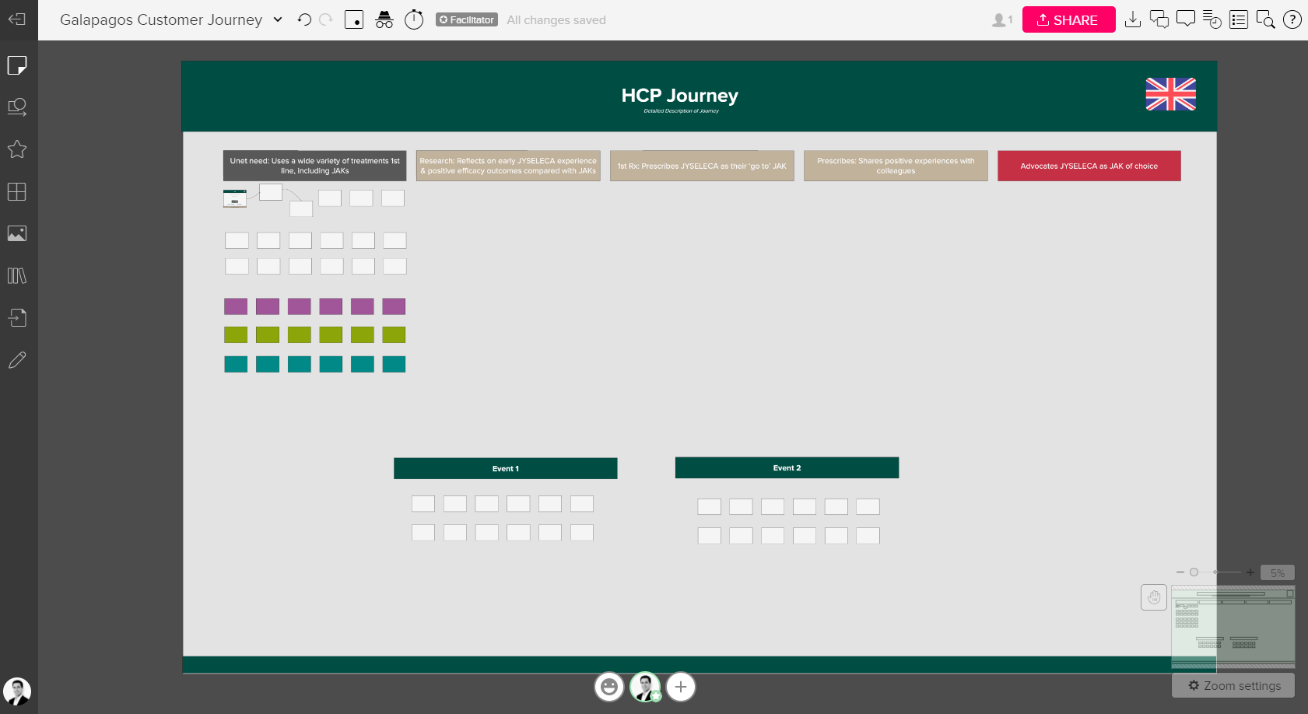
Mural
Mural is an alternative option that allows for visualisation of the entire journey together, with more flexibility for layouts and connections.
Can visualise entire journey
Maximum flexibility
More time to build
Visible to many users without license.

